Slide 1
HOW BUSINESSES USE INFORMATION SYSTEMS

Slide 2
HOW BUSINESSES USE INFORMATION SYSTEMS
A business is a formal organization that makes products or provides a service in order to make a profit.
Organizing a business: business functions and entities
There are four basic business functions: manufacturing and production, sales and marketing, finance and accounting, and human resources
There are five basic business entities: suppliers, customers, employees, invoices/payments, and products and services.

Slide 3
HOW BUSINESSES USE INFORMATION SYSTEMS
Business processes:
Manner in which work is organized, coordinated, and focused to produce a valuable product or service
Concrete work flows of material, information, and knowledge—sets of activities
Business processes also refer to unique ways to coordinate work, information, and knowledge
Information systems help organizations achieve great efficiencies by automating parts of processes

Slide 4
HOW BUSINESSES USE INFORMATION SYSTEMS
Information Systems also contributes to completely rethinking processes i.e. .
Change flow of information
Replace sequential steps with parallel steps
Eliminate delays in decision making
Business processes typically span several different functional areas.
Examples of Business Processes
Manufacturing and production:
- Assembling product, checking quality, producing bills of materials
Sales and marketing:
-Identifying customers, creating customer awareness, selling

Slide 5
HOW BUSINESSES USE INFORMATION SYSTEMS
Biz processes cont’d
Finance & accounting:
- Paying creditors, creating financial statements, managing cash accounts
Human resources:
- Hiring employees, evaluating performance, enrolling employees in benefits plans
Many business processes are cross-functional, transcending the boundaries between sales, marketing, manufacturing, and research and development.
These cross-functional processes cut across the traditional organizational structure, grouping employees from different functional specialties to complete a piece of work.

Slide 6
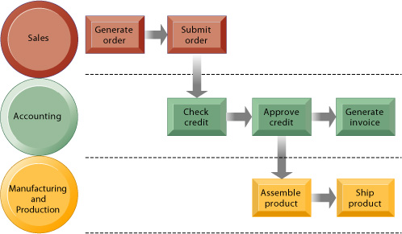
HOW BUSINESSES USE INFORMATION SYSTEMS
Example: Order Fulfillment Process at many companies requires cooperation among the sales function (receiving the order, entering the order), the accounting function (credit checking and billing for the order), and the manufacturing function (assembling and shipping the order)
Figure 2-12

Slide 7
HOW BUSINESSES USE INFORMATION SYSTEMS
ENTERPRISE APPLICATIONS- INTEGRATING FUNCTIONS AND BUSINESS PROCESSES
Enterprise applications:
Designed to support organization-wide process coordination and integration
Consist of:
Enterprise systems
Supply chain management systems
Customer relationship management systems
Knowledge management systems
These contemporary systems take advantage of corporate intranets and Web technologies that enable the efficient transfer of information within the firm and to partner firms. These systems are inherently cross-level, cross-functional, and business process oriented.

Slide 8
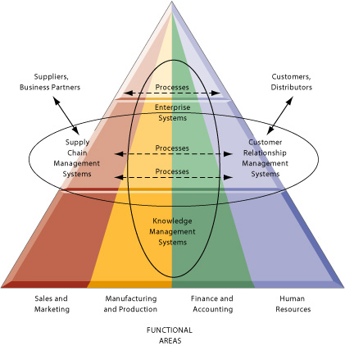
HOW BUSINESSES USE INFORMATION SYSTEMS
Enterprise Application Architecture

Slide 9
Enterprise Application Architecture
Enterprise systems create an integrated organization-wide platform to coordinate key internal processes of the firm.
Information systems for supply chain management (SCM) and customer relationship management (CRM) help coordinate processes for managing the firm’s relationship with its suppliers and customers.
Knowledge management systems enable organizations to better manage processes for capturing and applying knowledge and expertise.
Collectively, these four systems represent the areas in which corporations are digitally integrating their information flows and making major information system investments.

Slide 10
Enterprise Application Architecture
Traditional “Silo” View of Information Systems
Within the business: There are functions, each having its uses of information systems
Outside the organization’s boundaries: There are customers and vendors
Functions tend to work in isolation do not “talk” to each other and thus cannot automatically exchange information.
Managers might have a hard time assembling the data they need for a comprehensive, overall picture of the organization’s operations.

Slide 11
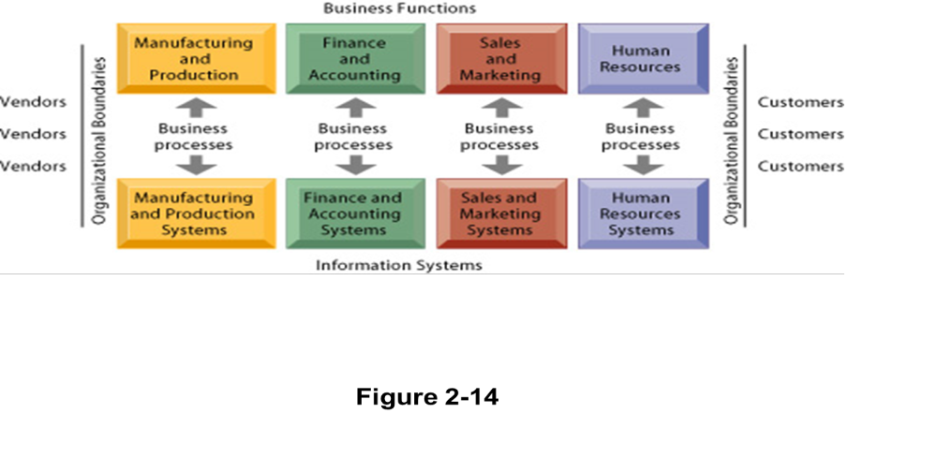
Enterprise Application Architecture
Traditional View of Systems

Slide 12
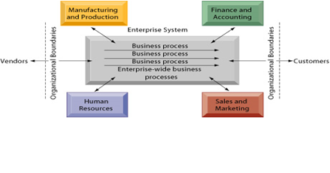
Enterprise Application Architecture

Slide 13
Enterprise Application Architecture
Enterprise Systems
Enterprise systems, also known as enterprise resource planning (ERP) systems, provide a single information system for organization-wide coordination and integration of key business processes.
Enterprise systems feature a set of integrated software modules and a central database that enables data to be shared by many different business processes and functional areas throughout the enterprise.
Information that was previously fragmented in different systems can seamlessly flow throughout the firm so that it can be shared by business processes in manufacturing, accounting, human resources, and other areas.

Slide 14
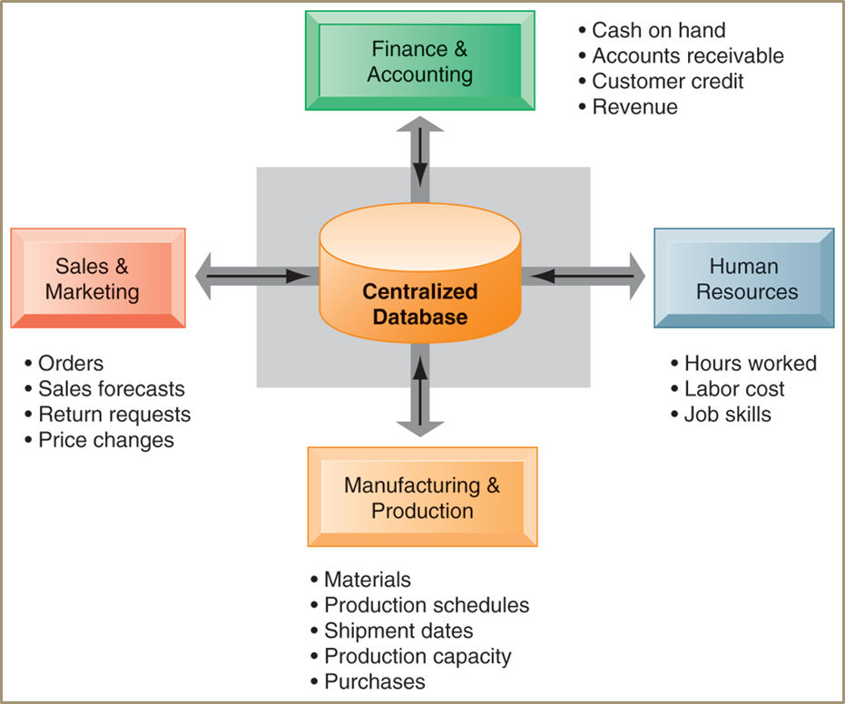
Enterprise Application Architecture
Enterprise systems

Slide 15
Enterprise Application Architecture
Benefits of Enterprise Systems
Collects data from different firm functions and stores data in single central data repository
Managers emerge with more precise and timely information for coordinating the daily operations of the business and a firm-wide view of business processes and information flows.
More efficient operations & Efficient response to customer orders (production, inventory)
Include analytical tools to evaluate overall organizational performance

Slide 16
Enterprise Application Architecture
Challenges of Enterprise Systems
Difficult to build: Require fundamental changes in the way the business operates
Technology: Require complex pieces of software and large investments of time, money, and expertise
Centralized organizational coordination and decision making: Not the best way for the firms to operate

Slide 17
Enterprise Application Architecture
Supply Chain Management (SCM
Closes the linkage and coordination of activities involved in buying, making, and moving a product
Integrates supplier, manufacturer, distributor, and customer logistics time
Reduces time, redundant effort, and inventory costs
Network of organizations and business processes
Helps in procurement of materials, transformation of raw materials into intermediate and finished products
Helps in distribution of the finished products to customers
Includes reverse logistics - returned items flow in the reverse direction from the buyer back to the seller

Slide 18
Enterprise Application Architecture
Information from Supply Chain Management Systems helps firms:
Decide when and what to produce, store, and move
Rapidly communicate orders
Track the status of orders
Check inventory availability and monitor inventory levels
Reduce inventory, transportation, and warehousing costs
Track shipments
Plan production based on actual customer demand
Rapidly communicate changes in product design

Slide 19
Enterprise Application Architecture
Customer Relationship Management (CRM
Instead of treating customers as exploitable sources of income, businesses are now viewing them as long-term assets to be nurtured through customer relationship management.
Customer relationship management (CRM) systems focus on coordinating all of the business processes surrounding the firm’s interactions with its customers in sales, marketing, and service to optimize revenue, customer satisfaction, and customer retention.
The ideal CRM system provides end-to-end customer care from receipt of an order through product delivery.
Provides end- to- end customer care and provides a unified view of customer across the company

Slide 20
Enterprise Application Architecture
CRM cont’d
Consolidates customer data from multiple sources and provides analytical tools for answering questions
Good CRM systems provide data and analytical tools for answering questions such as these:
What is the value of a particular customer to the firm over his or her lifetime?
Who are our most loyal customers? (It can cost six times more to sell to a new customer than to an existing customer.)
Who are our most profitable customers? What do these profitable customers want to buy?
Firms can then use the answers to these questions to acquire new customers, provide better service and support to existing customers, customize their offerings more precisely to customer preferences, and provide ongoing value to retain profitable customers.

Slide 21
Enterprise Application Architecture
Business value of CRM
Increased customer satisfaction
Reduced direct-marketing costs
More effective marketing
Lower costs for customer acquisition/retention
Increased sales revenue
Reduce churn rate
- Number of customers who stop using or purchasing products or services from a company.
- Indicator of growth or decline of firm’s customer base

Slide 22
Enterprise Application Architecture
Knowledge Management Systems
Knowing how to do things effectively and efficiently in ways others cannot duplicate is prime source of profit and competitive advantage
  E.g., Having a unique build-to-order production system
Some firms perform better than others because they have better knowledge about how to create, produce, and deliver products and services.
KMS collects relevant knowledge and make it available wherever and whenever it is needed to support business processes and management decisions
Also link the firm to external sources of knowledge

Slide 23
Enterprise Application Architecture
KMS cont’d
Support processes for acquiring, storing, distributing, and applying knowledge
They include enterprise-wide systems for:
- Managing and distributing documents, graphics, and other digital knowledge objects
- Systems for creating corporate knowledge directories of employees with special areas of expertise.
- Office systems for distributing knowledge and information, and
- Knowledge work systems to facilitate knowledge creation.

Slide 24
Enterprise Application Architecture
Knowledge management systems: Set of business processes developed in an organization to create, store, transfer, and apply knowledge
Knowledge management value chain:
Each stage adds value to raw data and information as they are transformed into usable knowledge
  Knowledge acquisition
  Knowledge storage
  Knowledge dissemination
  Knowledge application

Slide 25
Enterprise Application Architecture
Knowledge management value chain
1. Knowledge acquisition
Documenting tacit and explicit knowledge
- Storing documents, reports, presentations, best practices
- Unstructured documents (e.g., e-mails)
- Developing online expert networks
Creating knowledge
Tracking data from TPS and external sources

Slide 26
Enterprise Application Architecture
KM value chain cont’d
2. Knowledge storage
Databases
Document management systems
Role of management:
-Support development of planned knowledge storage systems
-Encourage development of corporate-wide schemas for indexing documents
-Reward employees for taking time to update and store documents properly

Slide 27
Enterprise Application Architecture
3. Knowledge dissemination
Portals
Push e-mail reports
Search engines
Collaboration tools
A deluge/ flooding of information?
- Training programs, informal networks, and shared management experience help managers focus attention on important information

Slide 28
Enterprise Application Architecture
4. Knowledge application
To provide return on investment, organizational knowledge must become systematic part of management decision making and become situated in decision-support systems
- New business practices
- New products and services
- New markets

Slide 29

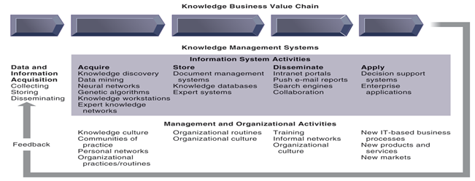
THE KNOWLEDGE MANAGEMENT VALUE CHAIN

Slide 30
THE KNOWLEDGE MANAGEMENT VALUE CHAIN
Requirements of knowledge work systems
  Substantial computing power for graphics, complex calculations
  Powerful graphics and analytical tools
  Communications and document management
  Access to external databases
  User-friendly interfaces
  Optimized for tasks to be performed (design engineering, financial analysis)

Slide 31
OTHER ENTERPRISE APPLICATIONS
Manufacturing and Production Systems: machine control, production planning, facilities allocation.
Sales and Marketing Systems: order processing, pricing analysis and sales trend forecasting
Human Resource Management Systems: Training and development, compensation analysis, HR planning
Accounting and Finance Systems: order processing, inventory control, accounts receivable, accounts payable, payroll

